Slide 1
The Demographic and Health Surveys (DHS)
GBH390: Numbers into Stories

Slide 2
What is the Demographic and Health Survey?
The DHS: An Overview
Demographic – Population structure, fertility, migration, etc.
Health – Maternal & child health, nutrition, infectious diseases
Survey – Nationally representative, sample-based data collection
Key Features
Funded by USAID, implemented by local statistical agencies
Standardized design enables cross-country comparisons
Includes country-specific modules to reflect local health priorities
E.g., malaria testing only in high-risk areas

Slide 3
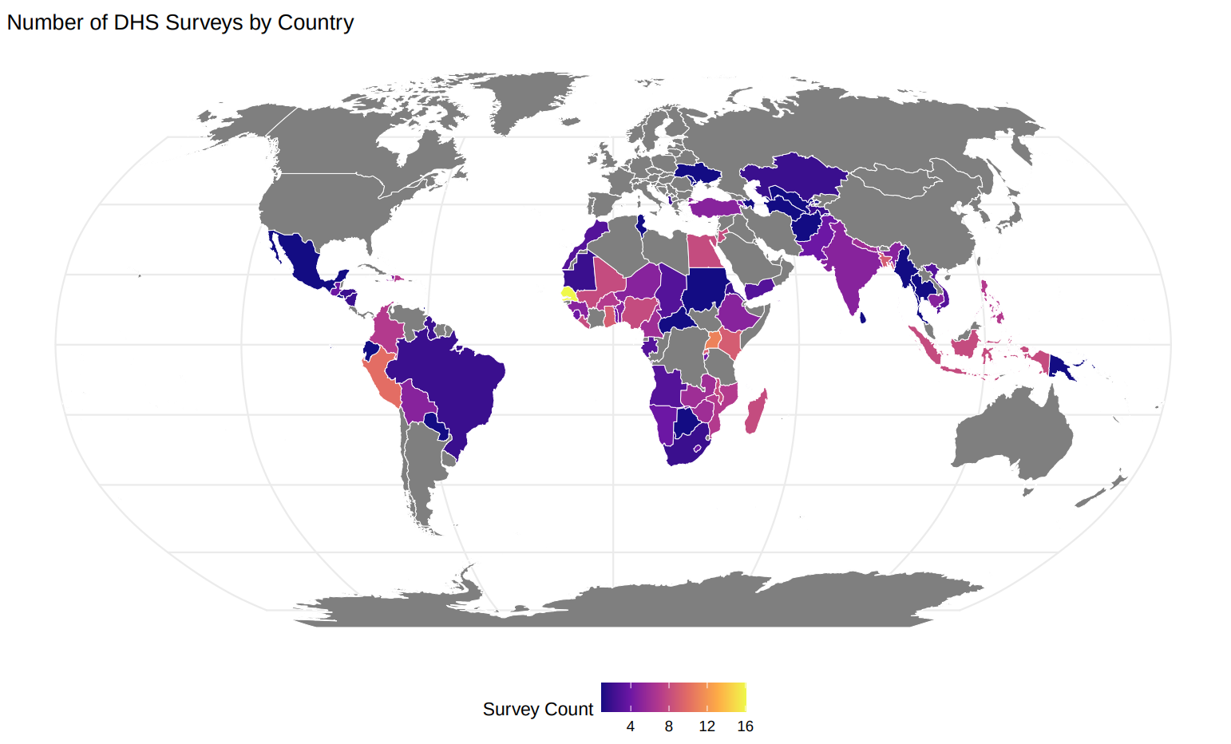

Slide 4
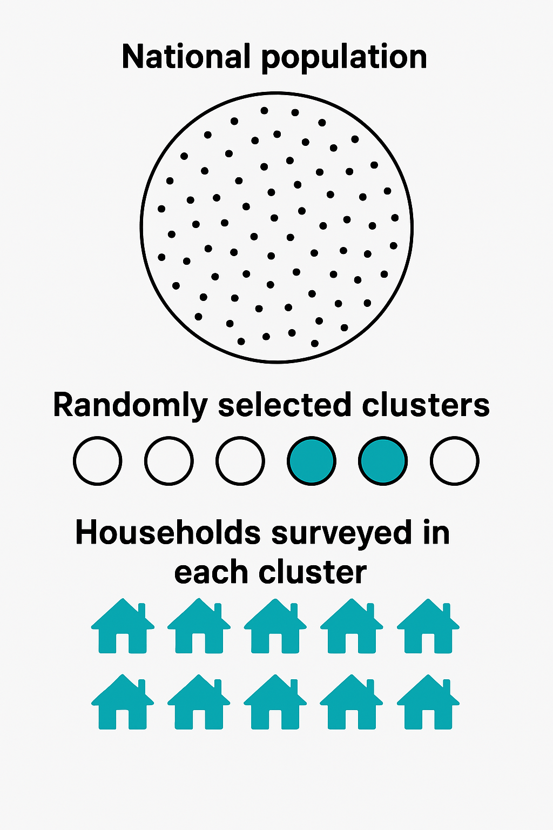





DHS Sampling
The DHS are nationally representative surveys.
Hierarchical samples, with “clusters”.
Within each cluster, random sample of households are interviewed.

Slide 5
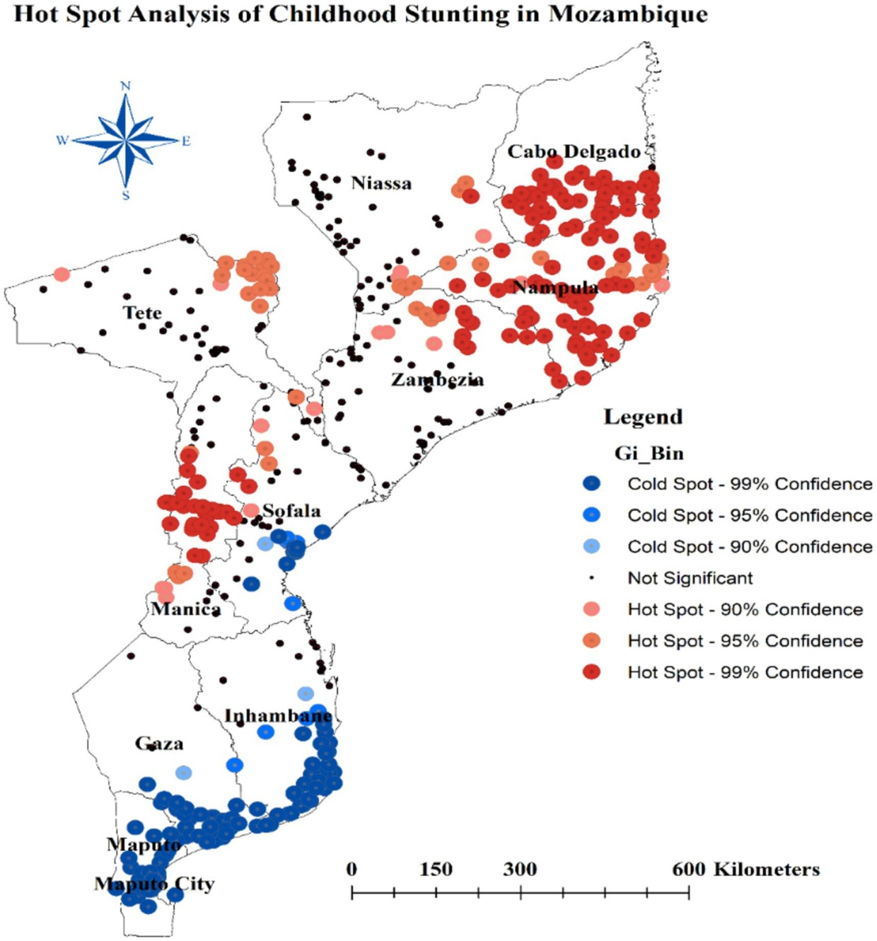
DHS Clusters
Source: Tamir et al. 2025 Data: Mozambique DHS 2022
DHS Clusters are small geographic units—typically villages (rural) or neighborhoods (urban).
Each dot on the map represents one cluster.
Colors indicate degree of childhood stunting.

Slide 6
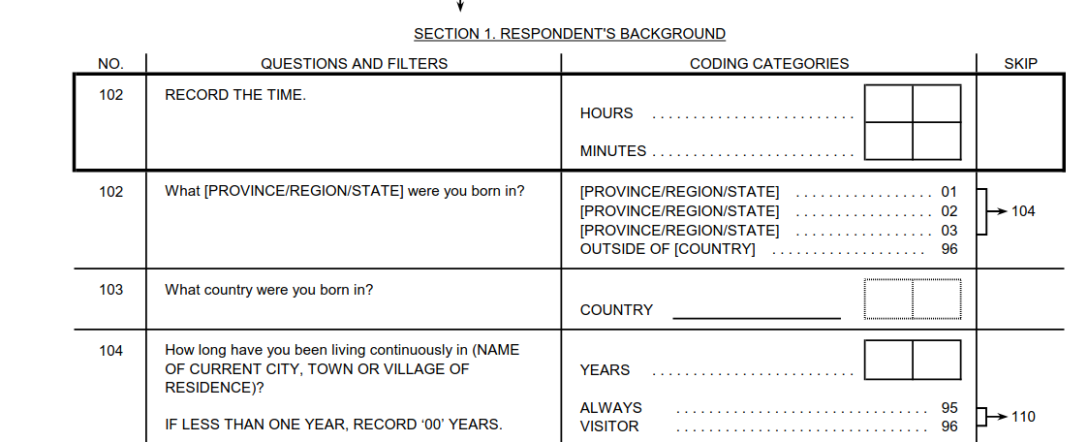
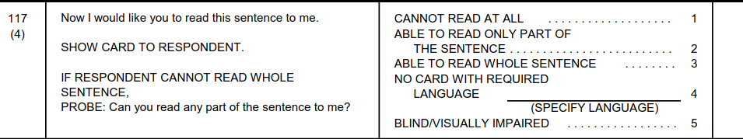
DHS Data Collection
Survey takers go to the households and ask a series of questions.
This can take a long time! About an hour per person.
Two levels of data:
Household
Individual
Includes all women age 15-49, and children 0-5
Men are less often interviewed.

Slide 7
Key Variables in the DHS
Household level
Individual level
Assets:
Vehicles and appliances (motorcycle, car, bicycle)
Housing (floor material, roof material)
Agriculture (livestock, land owned)
Family structure
Water access and sources
Geo-Location (cluster level)
Education
Physical health
Height and weight and biomarkers
Health care
Vaccinations
Pre/post natal care
Attitudes and norms
Domestic violence questions

Slide 8
Using DHS Data: Microdata
Cluster ID | Person ID | HH ID | Age | Anemia
001 | 001 | 001 | 15 | Yes
001 | 002 | 001 | 45 | No
001 | 003 | 001 | 31 | Yes
001 | 004 | 001 | 26 | No
001 | 001 | 002 | 17 | Yes
001 | 001 | 002 | 43 | No
Microdata means individual or household level records.
Each row is an individual or a household.
Each column is a characteristic.
This is the data we will use! Most important for researchers.
Age Group | Proportion Anemic
15-30 | 2/3
30-45 | 1/3

Slide 9
Crosstabs
Cluster ID | Person ID | HH ID | Age | Anemia
001 | 001 | 001 | 15 | Yes
001 | 002 | 001 | 45 | No
001 | 003 | 001 | 31 | Yes
001 | 004 | 001 | 26 | No
001 | 001 | 002 | 17 | Yes
001 | 001 | 002 | 43 | No
Crosstabulations (crosstabs):
Aggregation of microdata.
Choose an outcome
Choose a margin.
Summarize the individual records into a new, smaller table.
Age Group | Proportion Anemic
15-30 | 2/3
30-45 | 1/3

Slide 10
DHS StatCompiler
The DHS StatCompiler is an online tool for aggregating data (making crosstabs).
We will use R in this class, to have more flexibility, but the StatCompiler is very useful for quickly making summary statistics.
Often used by policy makers and activists.
https://www.statcompiler.com/en/

Slide 11
Exercise: DHS StatCompiler
Go to https://www.statcompiler.com/en/
Select Mozambique.
Pick an indicator which interests you.
Make crosstabs of the indicator by some relevant margin.
Present this to your neighbor.

Slide 12
